Slide 1
SMISHING
NAAN MUDHALVAN PROJECT
DONE BY:
YUVARAJ.G – AALIM MUHAMMED SALEGH COLLEGE OF ENGINEERING
COMPUTER SCIENCE & ENGINEERING – III YEAR

Slide 2
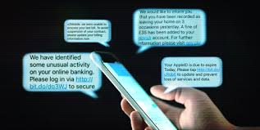
WHAT IS SMISHING?
Smishing is a social engineering attack that uses fake mobile text messages to trick people into downloading malware, sharing sensitive information or sending money to cybercriminals. The term “smishing” is a combination of “SMS”—or “short message service,” the technology behind text messages—and “phishing.”

Slide 3
OUTLINE:
PROBLEM STATEMENT
PROPOSED SYSTEM/SOLUTION
SYSTEM DEVELOPMENT APPROACH
ALGORITHM & DEPLOYMENT
RESULT
CONCLUSION
FUTURE SCOPE
REFERENCES

Slide 4
PROBLEM STATEMENT:
Smishing, a portmanteau of "SMS" and "phishing," refers to fraudulent text messages sent to deceive individuals into disclosing sensitive information, downloading malware-infected attachments, or visiting malicious websites. As traditional email phishing defenses improve, cybercriminals increasingly turn to smishing due to its effectiveness and the widespread use of mobile devices. The problem lies in the difficulty of detecting and preventing smishing attacks, which can lead to compromised personal and financial information, identity theft, and other cybercrimes.

Slide 5
PROPOSED SOLUTION:
Addressing smishing requires a combination of technological solutions, user education, and industry collaboration. Here are some proposed solutions:
1.Advanced Detection Algorithms:
Develop AI-driven algorithms for real-time detection of smishing messages.
Analyze content, sender information, and behavioral patterns to identify suspicious messages.
2. Integration with SMS Infrastructure:
Integrate detection algorithms into existing SMS gateways and mobile network infrastructure.
Ensure scalability and efficiency in processing large volumes of SMS messages.
3. User Education and Awareness:
Launch educational campaigns to raise awareness about smishing risks and prevention methods.
Provide users with tools and guidelines for verifying message authenticity and reporting suspicious messages.

Slide 6
4. Collaboration with Stakeholders:
Partner with mobile network operators, regulatory bodies, and cybersecurity experts.
Establish industry-wide standards and best practices for combating smishing.
5. Continuous Improvement and Updates:
Regularly update detection algorithms to adapt to evolving smishing tactics.
Monitor and analyze smishing trends to enhance detection capabilities and response strategies.
6. Privacy and Compliance:
Ensure compliance with privacy regulations and data protection standards.
Implement measures to safeguard user data during detection and response processes.

Slide 7
SYSTEM APPROACH:
The "System Approach" section outlines the overall strategy and methodology for developing and implementing the rental bike prediction system. Here's a suggested structure for this section:
Identify stakeholders involved in SMS ecosystem.
Analyze ecosystem for vulnerabilities and intervention points.
Conduct risk assessment to identify smishing threats.
Develop technical solutions like AI-driven detection algorithms.
Implement user education initiatives to raise awareness.
Foster collaboration among stakeholders for information sharing.
Continuously monitor and update systems for effectiveness.
Ensure compliance with privacy regulations and standards.
Establish feedback mechanisms for improvement.
Develop emergency response plans for large-scale incidents.

Slide 8



ALGORITHM & DEPLOYMENT:
DATA ANALYSIS:
Continuously analyze SMS traffic patterns and content to identify suspicious activities and refine the detection algorithms.
CLOUD DEPLOYMENT:
Deploy the smishing detection system in a scalable, cloud-based infrastructure to ensure high availability and efficient processing of SMS traffic.
MACHINE LEARNING:
Leverage advanced machine learning techniques to improve the accuracy and responsiveness of the smishing detection system.

Slide 9
RESULT:

Slide 10
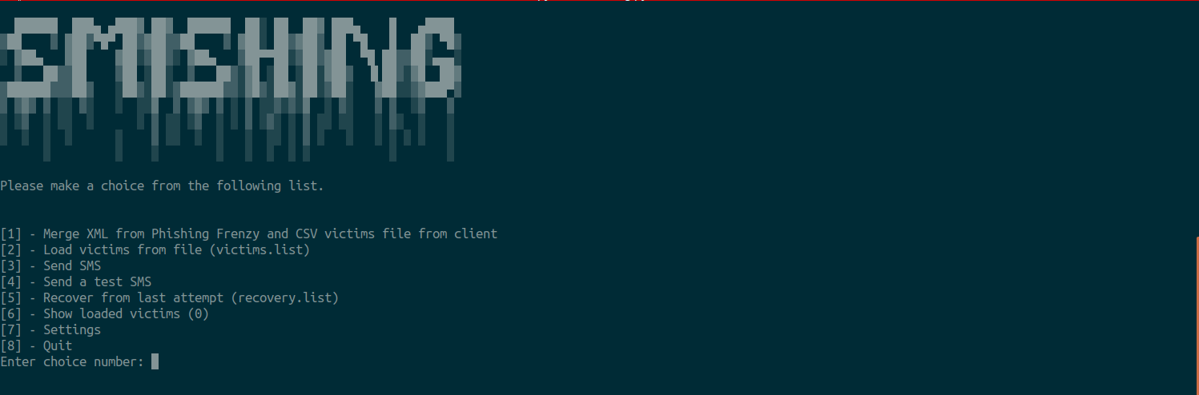

Slide 11
CONCLUSION:
In conclusion, smishing represents a persistent and evolving threat to the security of SMS communications. To effectively combat this menace, a multifaceted approach combining advanced technological solutions, user education, and collaborative efforts among stakeholders is essential. By leveraging AI-driven detection algorithms, implementing sender reputation systems, and fostering user awareness, we can mitigate the risks posed by smishing and protect individuals and businesses from falling victim to fraudulent SMS messages. Continued vigilance, innovation, and cooperation will be key in staying ahead of smishing threats and ensuring the integrity of SMS communications.

Slide 12
FUTURE SCOPE:
AI-driven Attacks: Utilization of AI for crafting more sophisticated and personalized smishing messages.
AR and VR Integration: Exploration of AR and VR technologies for immersive smishing experiences.
IoT Exploitation: Targeting of IoT devices for smishing attacks due to increasing connectivity.
Biometric Authentication Vulnerabilities: Exploitation of biometric authentication methods for smishing attacks.
Blockchain-based Solutions: Integration of blockchain for secure verification of SMS message authenticity.

Slide 13
REFERENCES:
Jakobsson, Markus, and Jacob Ratkiewicz. "Designing ethical phishing experiments: a study of (ROT13) rOnl Query Features." Financial Cryptography and Data Security. Springer, Berlin, Heidelberg, 2006.
Aljawarneh, Shadi, et al. "A Review of Smishing Attack: Techniques, Challenges, and Open Issues." IEEE Access 9 (2021): 26879-26894.
Jagatic, Tomasz N., et al. "Social phishing." Communications of the ACM 50.10 (2007): 94-100.
Scarfone, Karen, and Peter Mell. "Guide to protecting the confidentiality of personally identifiable information (PII)." Special Publication 800-122 (2010): 1-38.
Vidas, Timothy, and Nicolas Christin. "A first look at mobile smishing." Proceedings of the 2014 ACM SIGSAC Conference on Computer and Communications Security. 2014.
Sheng, Steve, et al. "Exploring antiphishing blacklists: better coverage, timeliness, and accuracy through greylisting." Proceedings of the 15th ACM conference on Computer and communications security. 2008.

Slide 14
THANK YOU

